Slide 1
Mark 16:15-16
“Go Into All the World”
Richie Thetford www.thetfordcountry.com

Slide 2
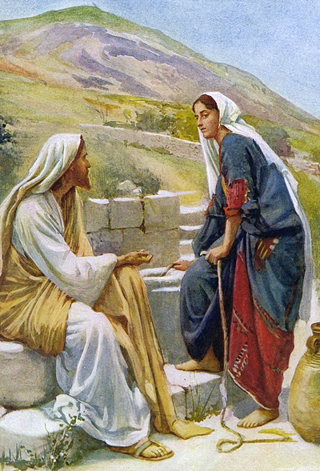
Christ Was A Soul Winner
Imitate the Lord’s example
Multitudes
Matthew 5-7
Nicodemus
John 3:1-13
Woman of Samaria
John 4:5-15
Richie Thetford www.thetfordcountry.com

Slide 3
Early Christians Were Soul Winners
Disciples began in Jerusalem
Persecution did not deter them
Acts 5:42
Went everywhere preaching
Acts 8:1-4
Took the great commission seriously
Richie Thetford www.thetfordcountry.com

Slide 4
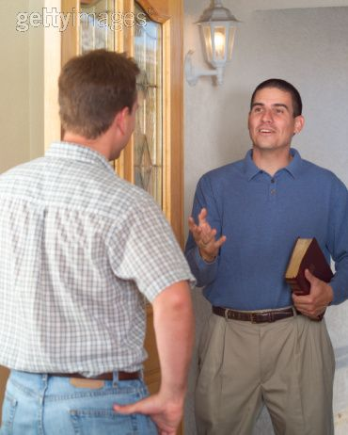
Every Christian Has This Responsibility
Personal responsibility to seek the lost
Every Christian
2 Timothy 2:2
1 Peter 3:15
Emphasized in the New Testament
Philippians 1:14
Jude 3
Every Christian should be involved in seeking the lost
Richie Thetford www.thetfordcountry.com

Slide 5
Soul Winning Is Good for the Soul Winner
“the saved are saved to save others”
Be faithful
John 15:1-6
Gives the Christian great joy!
Galatians 3:27
Soul winning gives one encouragement
When individuals are converted to Christ, then the church will flourish!
Richie Thetford www.thetfordcountry.com

Slide 6
Conclusion
Remember Paul’s words:
Ephesians 5:16
2 Corinthians 6:2
Teach others about Christ
Let our lights shine bright
Matthew 5:16
“redeeming the time, because the days are evil”
Richie Thetford www.thetfordcountry.com

