Slide 1


1 Corinthians 13
Examining the importance of growing up in
FAITH, HOPE, and LOVE
Richie Thetford www.thetfordcountry.com

Slide 2

Growing in Faith
Begins small but grows to full strength over time
We discover we are sinners
  Romans 3:23
  Isaiah 59:1-2
  Romans 6:23
  Romans 5:6-8
Our hope is found in Jesus
  1 Peter 1:18-19
Richie Thetford www.thetfordcountry.com

Slide 3

Growing in Faith
God sent His Son
“we must be baptized in Jesus”
  Matthew 7:13-14
  Romans 12:1-2
Transitioning from first
faith to a mature faith
  Increase in knowledge
    Hebrews 5:12-14
    Romans 10:17
Richie Thetford www.thetfordcountry.com

Slide 4
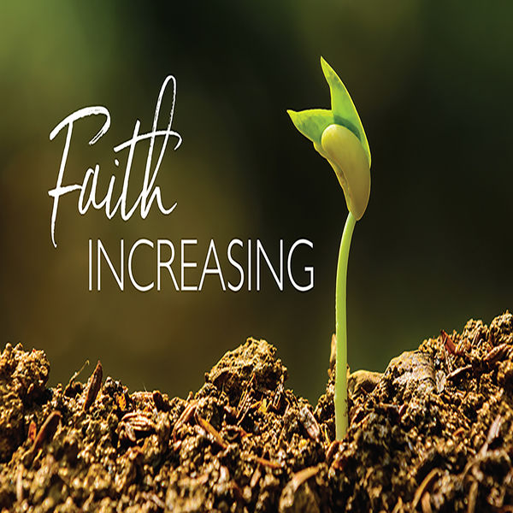
Growing in Faith
Transitioning from first faith to a mature faith
  Walk in God’s help
    Romans 10:5-10
  Seek to live up to our calling
    Romans 5:6-11
  Conduct ourselves in careful
  steps of righteousness daily
    Ephesians 5:6-10, 15-16
Richie Thetford www.thetfordcountry.com

Slide 5

Growing in Hope
Level of hope is an indication of maturity
  Matthew 19:16
Being relieved of guilt
  Acts 2:47
We grow and desire for a better
life in heaven
  2 Peter 3:10-13
  Philippians 3:12-15
  Ephesians 5:8-10; Philippians 4:4-9
Richie Thetford www.thetfordcountry.com

Slide 6

Growing in Love
Mature understandings of love
  Matthew 13:20-21
Winds of doctrine will unsettle us
  Ephesians 4:14
  John 6:66
We love God first and foremost
  John 14:15
  1 Peter 1:6-9
Richie Thetford www.thetfordcountry.com

Slide 7
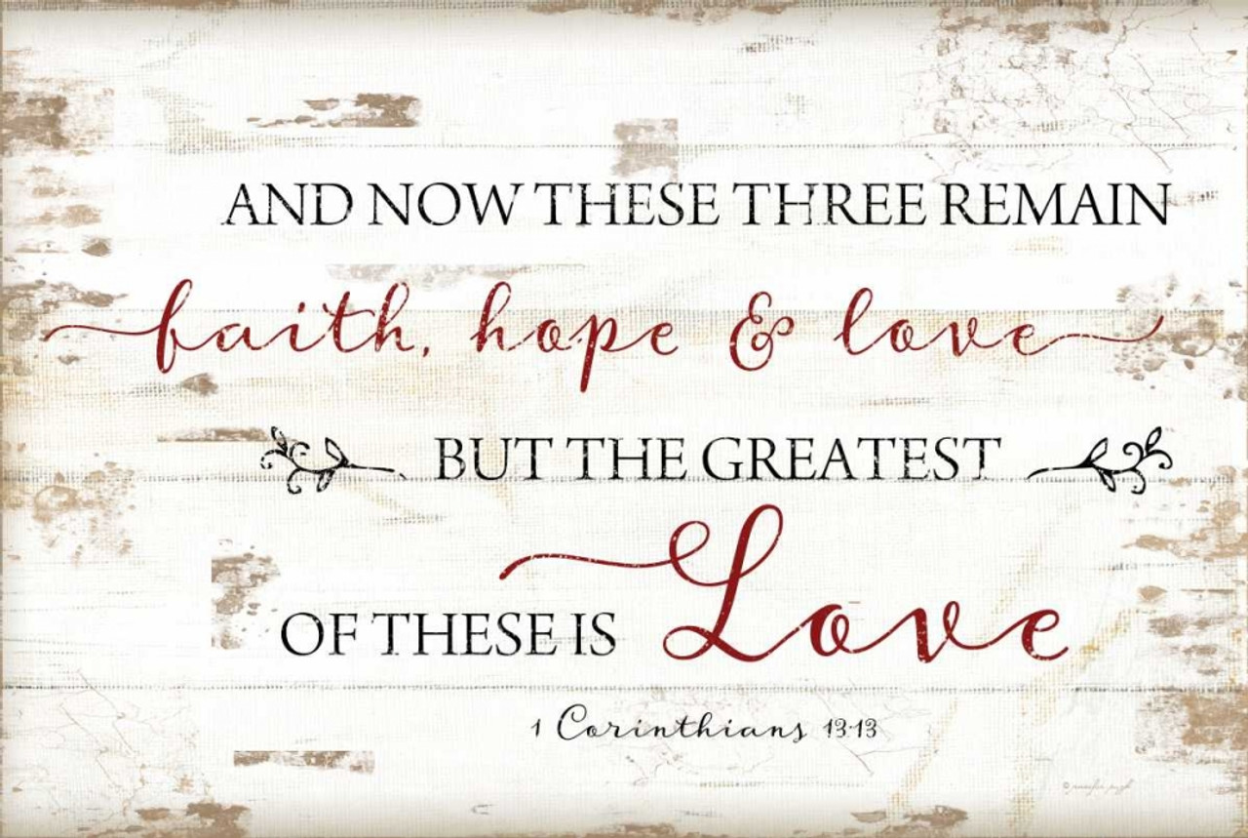
Conclusion
The apostle Paul says:
  1 Corinthians 13:13
    After faith is sight
    Hope is realized
    Love will continue
Now is the time to grow up
  Ephesians 4:15
Seek God in faith Pursue His offer of hope Embrace what His love affords
Richie Thetford www.thetfordcountry.com

