Slide 1
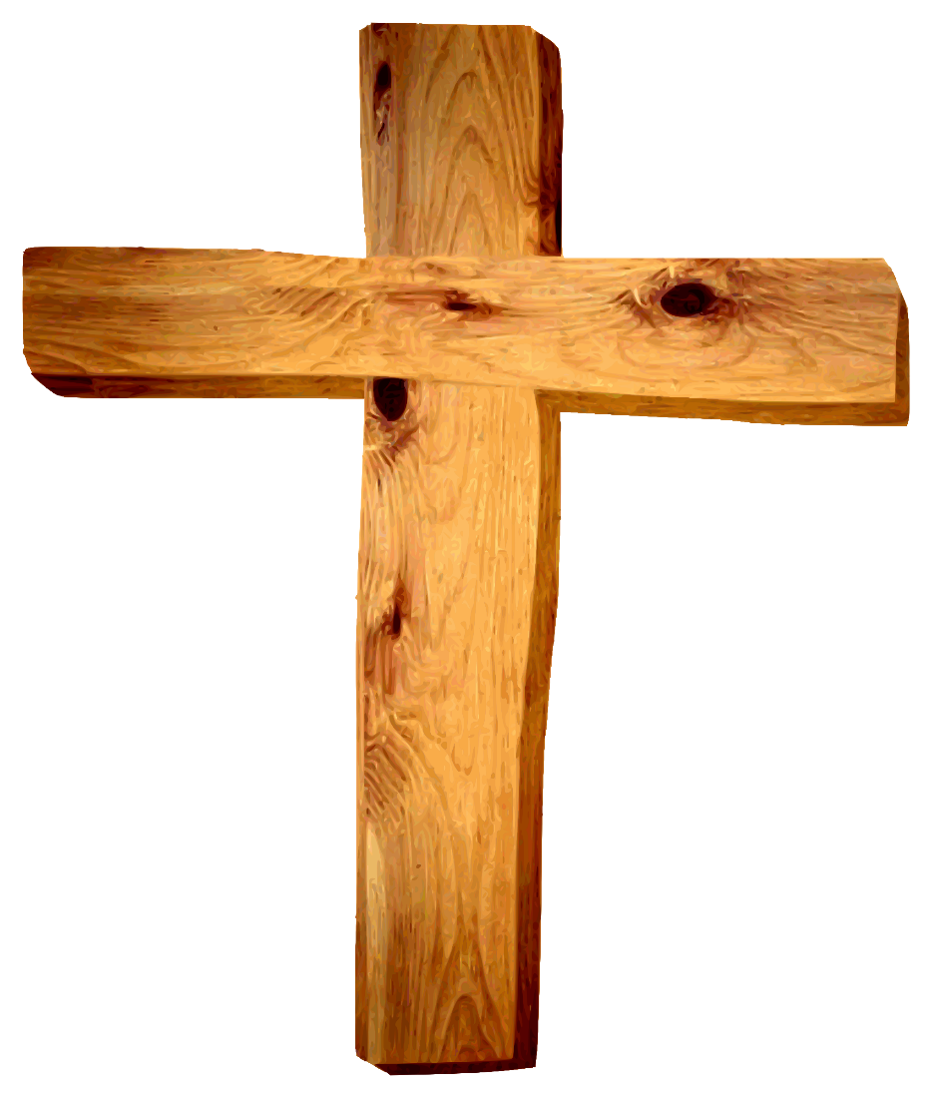
The Prophecy and Fulfillment of the Church
“You are the Christ, the Son of the living God”
“….on this rock I will build My church.”
“But you are a chosen generation, a royal priesthood,
a holy nation, His own special people, that you may proclaim the praises of Him who called you out of darkness into His marvelous light” 1 Peter 2:9
Richie Thetford www.thetfordcountry.com

Slide 2

The scriptures teach that the church of the New Testament
was established on the first Pentecost after the resurrection
of Jesus from the dead
“For where there is a testament, there must also of necessity be the death of the testator. For a testament is in force after men are dead, since it has no power at all while the testator lives.”
Hebrews 9:16-17
Richie Thetford www.thetfordcountry.com

Slide 3

Prophecy and Fulfillment
2 Samuel 7:12-17
David’s Seed
Acts 2:29-35
David’s Seed to Build
After His Death
Establish His Throne
Build His House
Christ is David’s Seed 2:30; 13:23
After His Death
2:29
On Throne Exalted
2:30-35
House Built
2:30, 47
Richie Thetford www.thetfordcountry.com

Slide 4

Prophecy and Fulfillment
Isaiah 2:2-3
Isaiah
Acts 2:17
Last Days
Mountain of the Lord’s House
Established on the Mountains
Word of the Lord
Law Out of Zion
All Nations
Last Days (2:17)
Church (2:47; 1 Timothy 3:15)
Jerusalem on Mountains
Word and Jerusalem (2:5, 14)
Law of Pardon (2:37)
All Nations (2:5)
Jerusalem
(Mt Zion)
Richie Thetford www.thetfordcountry.com

Slide 5
Prophecy and Fulfillment
DANIEL 2
“You are this head of gold”
Babylon Empire 607-537 BC
(Destroyed Jerusalem and carried Judah away captive)
“Another kingdom” (silver)
Persian Empire 537-330 BC
(Permitted the Jews to return from captivity and aided in the reestablishment as a nation of people)
Richie Thetford www.thetfordcountry.com

Slide 6
Prophecy and Fulfillment
“Third kingdom” (brass)
Greek Empire 330-146 BC
(Ruled Palestine in the period between the testaments. World power passed from Asia to Europe)
“The fourth kingdom” (iron)
Roman Empire 146 BC - 476 AD
“In the days of those kings the God of heaven will set up a kingdom which will never be destroyed,” (Daniel 2:44)
DANIEL 2
This eternal kingdom was to be established during the time of the fourth empire,
the Roman Empire! (Colossians 1:13-14; 2 Peter 1:10-11)
Richie Thetford www.thetfordcountry.com

Slide 7

Prophecy and Fulfillment
Mark 9:1
With Power
Acts 2:1-4
Power to Come
Kingdom to Come with Power
Some Would Live to See it
Some Would Die Before
Power Came (2:1-4
Kingdom Conferred (2:30)
Some Were Living (2:14)
Judas Was Dead (1:16-18)
Kingdom was to come with power; Power with Spirit;
Spirit came on Pentecost; Kingdom came on Pentecost!
Richie Thetford www.thetfordcountry.com

Slide 8

Kingdom Before
Kingdom After
“Will Build”
  Matthew 16:18
“Will Give”
  Matthew 16:19
“Shall Come”
  Matthew 6:10
“Is At Hand”
  Matthew 4:17; 10:7
“Has Come Near”
  Luke 10:9
In the Kingdom
  Revelation 1:6
Translated Into
  Colossians 1:13
Kingdom Conferred
  Acts 2:30
Came With Power
  Acts 2:1-4
Built in Jerusalem
  Acts 2:47
1 Corinthians 15:24
Richie Thetford www.thetfordcountry.com

Slide 9

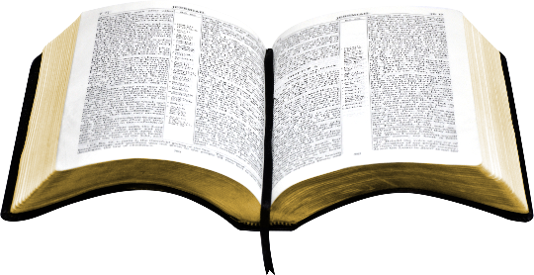
Five Essential Elements to the Existence of
the Church:
Jesus died for our sins as preached in Acts 2
Jesus was buried and arose from the dead as preached in Acts 2
Jesus ascended and sent the Holy Spirit of promise which was done on the day of Pentecost. Jesus was not glorified until this took place
Baptism is by Christ’s authority and before that time baptism was not preached by the authority
of Christ for the remission of sins
Salvation is in the name of Jesus (Acts 2:47)
Ephesians
1:20-23
All five of these elements were fulfilled on the day of Pentecost!
Richie Thetford www.thetfordcountry.com

