Slide 1
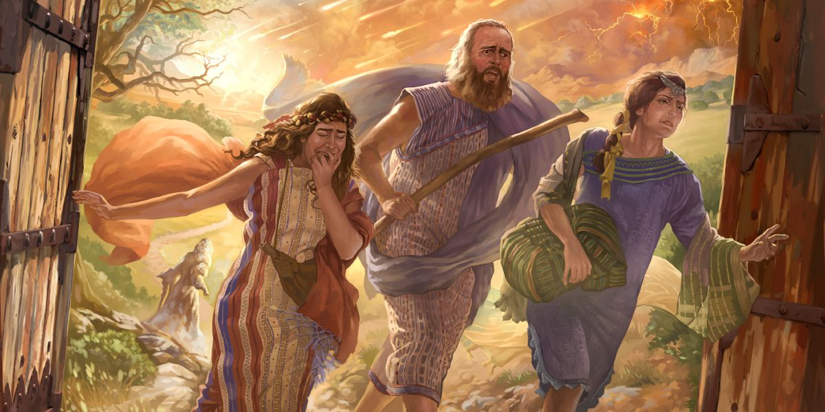
Escape for Your Life!
Matthew 23:33
Romans 2:3
1 Corinthians 10:13
Richie Thetford www.thetfordcountry.com

Slide 2
Old Testament Examples
Lot and his wife
Genesis 19:17
Noah and his family
Genesis 6:18
Israel leaving Egypt
Exodus 14:16, 30
The disobedient prophet
1 Kings 13:9-10
Richie Thetford www.thetfordcountry.com

Slide 3
Where Must We Escape to Gain Life?
To Mount Zion
Hebrews 12:22
To Christ and His church
Similarities between the ark and the church
One builder
Matthew 16:18
One building
Ephesians 4:4
Colossians 1:18
One kind of material
Galatians 3:26-27
One way to enter
John 10:7, 9
One source of light
Psalms 119:104
Richie Thetford www.thetfordcountry.com

Slide 4
Where Must We Escape to Gain Life?
To Be Baptized
1 Corinthians 10:1-2
Mark 16:16
To go through Christ to get to God
John 14:6
John 1:4
2 Timothy 2:10
Richie Thetford www.thetfordcountry.com

Slide 5
How May We Escape into Christ?
Believe
Romans 10:10
Repent
Acts 17:30
Confess
Matthew 10:32
Baptized INTO
Galatians 3:27
Richie Thetford www.thetfordcountry.com

Slide 6
From What Must We Escape?
Temptation
1 Corinthians 10:13
Pollution of the World
2 Peter 2:20
Idolatry
1 Corinthians 10:14
Indifference
Romans 12:11
Profanity and Vulgarity
Ephesians 4:29
Richie Thetford www.thetfordcountry.com

Slide 7
Why Is it Some do NOT Escape?
Refuse to listen to instruction
Hebrews 12:25
Some neglect to be saved
Hebrews 2:3
Some are hypocrites
Matthew 23:33
Richie Thetford www.thetfordcountry.com

Slide 8
Conclusion
By acting properly, we will escape the judgment of hell
Luke 21:36
Failing to escape will be sad!
2 Thessalonians 1:7-9
ESCAPE FOR YOUR SOUL’S LIFE – while Christ gives us opportunity
Matthew 10:28
Richie Thetford www.thetfordcountry.com

