Slide 1
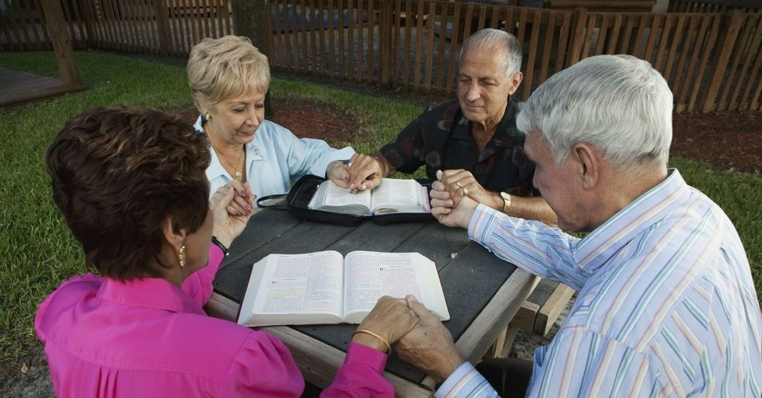
The
Elderly
Titus 2:1-8
Richie Thetford www.thetfordcountry.com

Slide 2
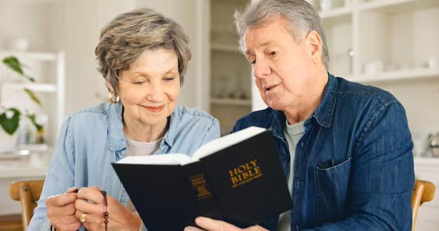
The Elderly
The elderly should never be ashamed of growing old
  Proverbs 20:29
May not be able to
do as much physically
  John 21:18
Richie Thetford www.thetfordcountry.com

Slide 3
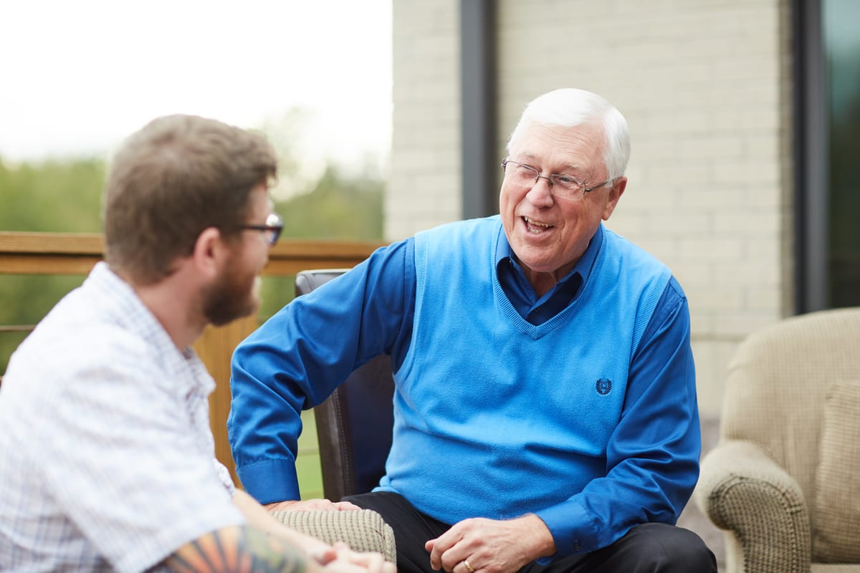
The Elderly Men
The spiritual elderly
men’s conduct
  Titus 2:2
Richie Thetford www.thetfordcountry.com

Slide 4
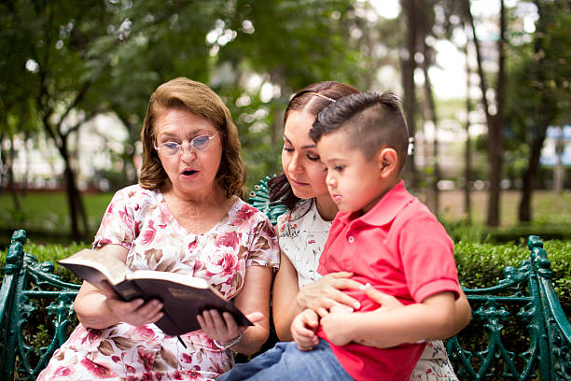
The Elderly Women
The spiritual elderly women’s conduct
  Titus 2:3-5
Admonish: “to warn; caution against certain faults; to advise; to remind”
Richie Thetford www.thetfordcountry.com

Slide 5

How the Young Should Treat Elderly Men
The Lord’s instruction
  Leviticus 19:32
Learn from King Rehoboam
  1 Kings 12:1-8
Be careful what you say
  2 Kings 2:19-24
Submit to them
  1 Peter 5:5
Richie Thetford www.thetfordcountry.com

Slide 6

How the Young Should Treat Elderly Women
Not to despise them
  Proverbs 23:22
Care for them
  1 Timothy 5:4
Treat them kindly
We need both the enthusiasm and work of the young
and the wisdom and counsel of the elderly
Richie Thetford www.thetfordcountry.com

