Slide 1

YOU
Joshua 24:14-15
Joshua 24:14-15
Richard Thetford www.thetfordcountry.com

Slide 2

Introduction
We have a choice
  Genesis 2:16-17
  John 7:17
  Matthew 11:28
  Psalms 119:30
Some remain loyal, no matter what!
  Philippians 4:22
Richard Thetford www.thetfordcountry.com

Slide 3
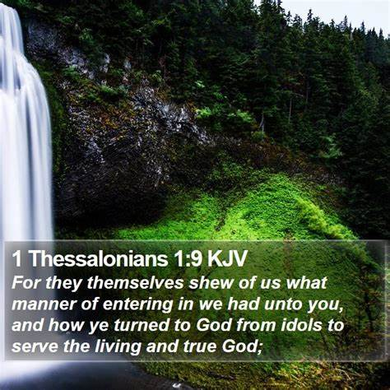
Moral Choice is Inescapable
The master we serve
  1 Thessalonians 1:9
  1 Kings 18:21
  Matthew 12:26, 30
  Romans 6:15-18
  Matthew 6:24
  Exodus 20:3; 23:24
Richard Thetford www.thetfordcountry.com

Slide 4

Moral Choice is Inescapable
The choice of causes
  Hebrews 11:24-26
  Acts 7:22
  Philippians 2:5-8
  Philippians 3:7-10
  Matthew 6:19
  Romans 8:18
Richard Thetford www.thetfordcountry.com

Slide 5

Moral Choice is Inescapable
The choice of destinies
  Matthew 7:13-14
Our choice of masters
and causes is our
choice of destinies.
Richard Thetford www.thetfordcountry.com

Slide 6
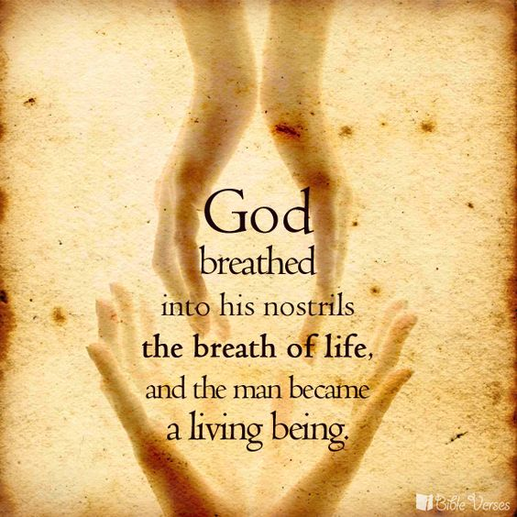
Moral Choice is Individual
God created us individually
  Genesis 2:7
God saves us individually
God will judge us individually
  2 Corinthians 5:10
Richard Thetford www.thetfordcountry.com

Slide 7
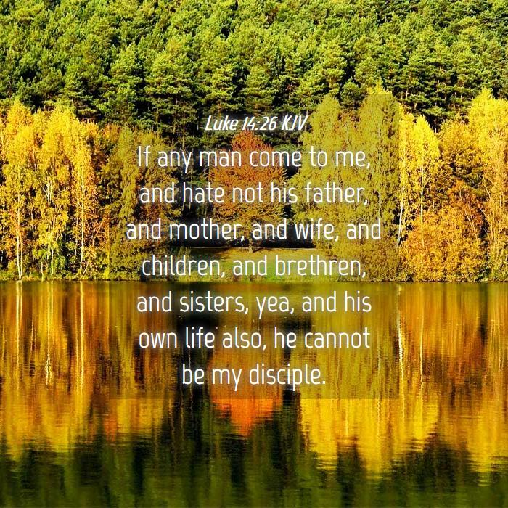
Moral Choice is Individual
Must be independent of:
  FAMILY
    Luke 14:26
  FRIENDS
  POPULAR CHOICE
“as for me and my house…”
  Ezekiel 18:20
Richard Thetford www.thetfordcountry.com

Slide 8

Moral Choice is Immediate
Between God and Satan
  2 Corinthians 6:2
  Hebrews 3:7-13
OR
To become a Christian and to be saved in heaven is not by
divine decree nor by accident, but by CHOICE
“Choose you this day whom you will serve”
Richard Thetford www.thetfordcountry.com

