Slide 1

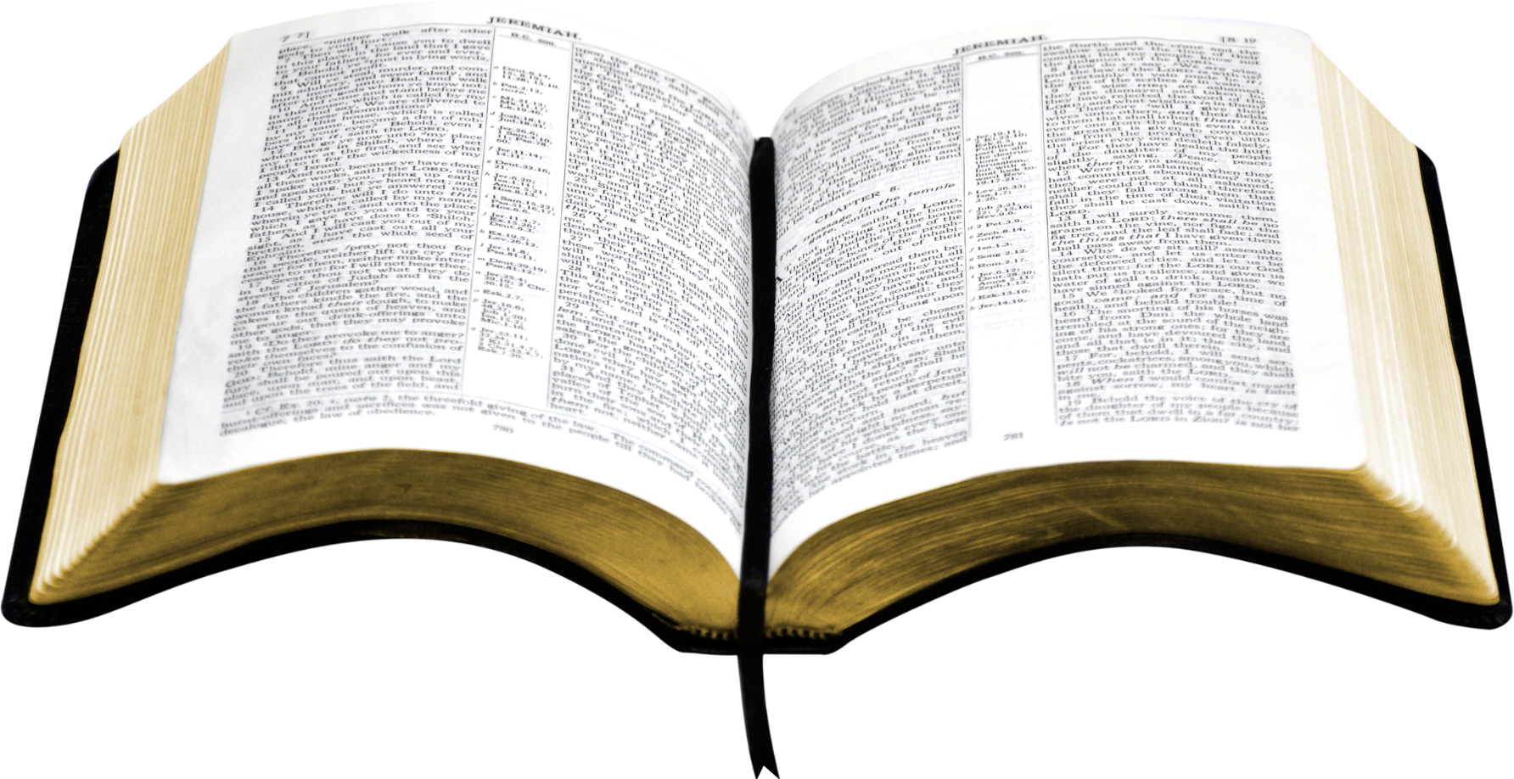
The Bible’s Guide For Unity
“Behold, how good and how pleasant it is For brethren to dwell together in unity!”
Psalms 133:1
Richie Thetford www.thetfordcountry.com

Slide 2
What Does the Bible Teach About Unity?
“I do not pray for these alone, but also for those who will believe
in Me through their word; that they all may be one, as You, Father,
are in Me, and I in You; that they also may be one in Us,
that the world may believe that You sent Me.”
John 17:20-21
“Be of the same mind toward one another. Do not set your mind on high things, but associate with the humble. Do not be wise in your own opinion.”
Romans 12:16
Richie Thetford www.thetfordcountry.com

Slide 3
What Does the Bible Teach About Unity?
“Now may the God of patience and comfort grant you to be like-minded toward one another, according to Christ Jesus,”
Romans 15:5
“Finally, brethren, farewell. Become complete. Be of
good comfort, be of one mind, live in peace; and the God of love
and peace will be with you.”
2 Corinthians 13:11
Richie Thetford www.thetfordcountry.com

Slide 4
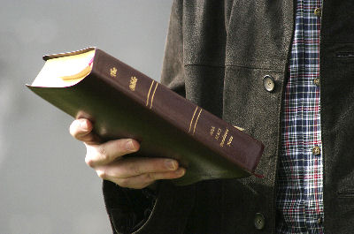
Unity Requires a Standard
A Standard requires submission
  Psalms 119:104-105; 40:8
Can’t set up unrealistic standards
  Matthew 7:21
  Acts 23:1
Richie Thetford www.thetfordcountry.com

Slide 5
The Bible is Our Standard
“Heaven and earth will pass away, but My words will by no means pass away.”
Matthew 24:35
“And you shall know the truth, and the truth shall make you free.”
John 8:32
“You are already clean because of the word which I have spoken to you.”
John 15:3
Richie Thetford www.thetfordcountry.com

Slide 6
The Bible is Our Standard
“The wicked have laid a snare for me,
Yet I have not strayed from Your precepts.”
Psalms 119:110
“The entrance of Your words gives light; It gives understanding to the simple.”
Psalms 119:130
“The entirety of Your word is truth, And every one of
Your righteous judgments endures forever.”
Psalms 119:160
Richie Thetford www.thetfordcountry.com

Slide 7
The Bible is Our Standard
“But the word of the LORD endures forever.
Now this is the word which by the gospel was preached to you.”
1 Peter 1:25
“For the word of God is living and powerful, and sharper than any two-edged sword, piercing even to the division of soul and spirit, and of joints and marrow, and is a discerner of the thoughts and intents of the heart.”
Hebrews 4:12
Richie Thetford www.thetfordcountry.com

Slide 8
The Bible is Our Standard
“All Scripture is given by inspiration of God, and is profitable for doctrine,
for reproof, for correction, for instruction in righteousness, that the man
of God may be complete, thoroughly equipped for every good work.”
2 Timothy 3:16-17
“He who rejects Me, and does not receive My words, has that which judges him--the word that I have spoken will judge him in the last day.”
John 12:48
Richie Thetford www.thetfordcountry.com

Slide 9

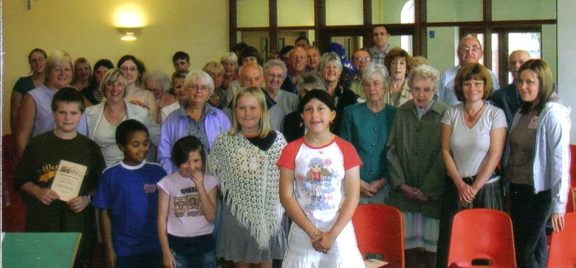
Some Have Not Learned the
Importance of Listening to God
Bible unity is only achieved by keeping God’s Word
  Nadab & Abihu (Leviticus 10:1-2)
  Uzzah (2 Samuel 6:6-7)
  Today (2 John 9)
We must never seek unity at all costs. We must seek unity based on the truth.
UNITY
Richie Thetford www.thetfordcountry.com

Slide 10
Unity in Practice
Commanded to have unity
  1 Corinthians 1:10
Must exhibit genuine care and concern for Christ and the Brethren
  Philippians 2:1-4
Love is a necessary ingredient
  1 John 4:7-8, 20-21
Jerusalem church proved the possibility and blessings of unity
  Acts 2:42-47; 4:32
Bible unity has been established
  Ephesians 4:1-7
Must stay focused on the Bible to achieve UNITY
Richie Thetford www.thetfordcountry.com

Slide 11

Is it Possible for us to Have
UNITY?
Yes, IF
One is willing to repent and submit to the authority of Christ
May we all strive to put God and others first in our life so that we can remain focused on His will while teaching and exhorting one another!
Richie Thetford www.thetfordcountry.com

